Slide 1
Credential Harvesting Lab
Lab contributions from
Dr. John Guo, James Madison University

Slide 2
Credentials Harvesting Lab
Materials needed
Kali Linux Virtual Machine
Windows 7 Virtual Machine
Software Tools used (On the Kali Linux OS)
SET (Social-Engineering Toolkit)

Slide 3
Objectives Covered
Security+ Objectives (SY0-601)
Objective 1.1 – Compare and contrast different types of social engineering techniques.
Credential Harvesting

Slide 4
What is Credential Harvesting?
A malicious actor attempting to obtain log-in credentials from victims
Create a fake website
Clone of a real website
Get the victim to visit the website
Victim enters their username/password
Does not actually authenticate
Malicious actor sees their username/password

Slide 5
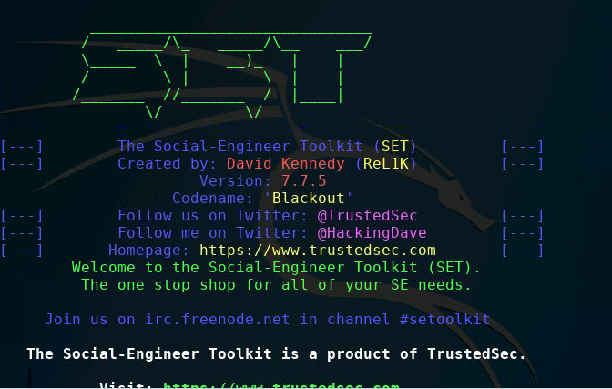
The Credential Harvesting Lab
Set up Environments
Find IP Addresses
Verify Connection
Open SET Toolkit
Launching the attack
Playing the victim
Seeing the attack

Slide 6
Setup Environments
Log into your range
Open the Kali Linux and Windows 7 Environments
You should be on your Kali Linux Desktop
You should also be on your Windows 7 Desktop

Slide 7

Find the IP Address (Kali Machine)
You will need the IP address of the Kali machine
Open the Terminal
In the Linux VM, open the Terminal and type the following command:
hostname -I
This will display the IP Address
Write down the Kali VM IP address
The IP Address

Slide 8
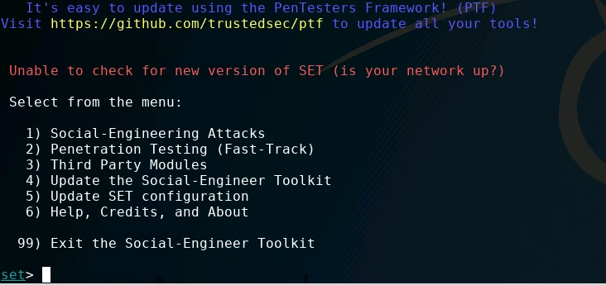
Open SEToolkit
In the Kali environment, open Terminal
Enter the following command to open the SEToolkit:
sudo setoolkit
When asked if you agree to terms and conditions, type y and press ENTER.
SEToolkit’s Home Menu

Slide 9
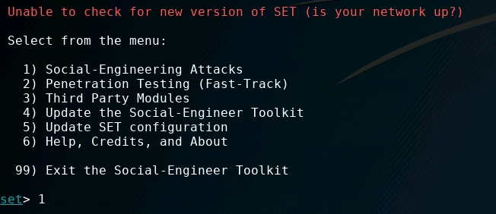
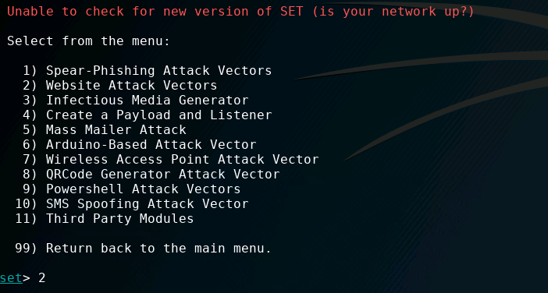
Launching the Attack
Option 1: Social-Engineering Attacks
In the SEToolkit, you will select what attack you want to run.
Press 1 and ENTER to open the Social-Engineering Attacks
Once the Social Engineering Attacks load, press 2 and ENTER to open the Website Attack Vectors
Option 2: Website Attack Vectors

Slide 10
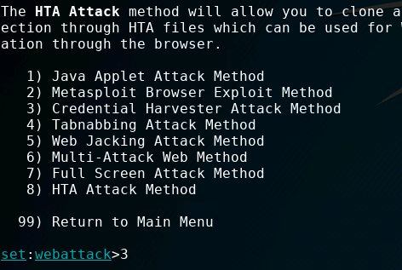
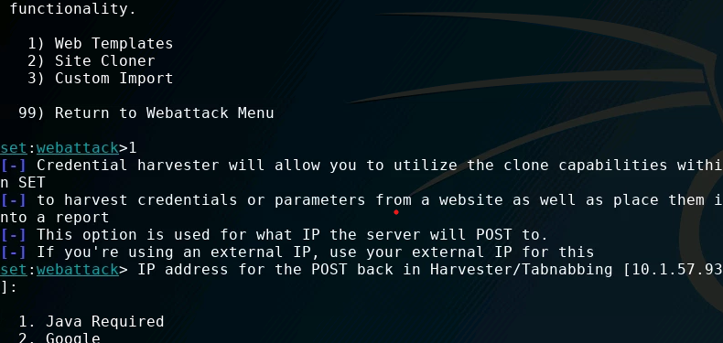
Launching the Attack
Option 3: Credential Harvester Attack
Once the Website Attack Vectors load, press 3 and ENTER to run a Credential Harvester Attack
Now, we are going to use the Web Templates, so press 1 and ENTER
Verify that the IP Address is the same as your Kali’s IP Address, and press ENTER again
Option 1: Web Templates
Verify your Kali IP address and hit ENTER

Slide 11
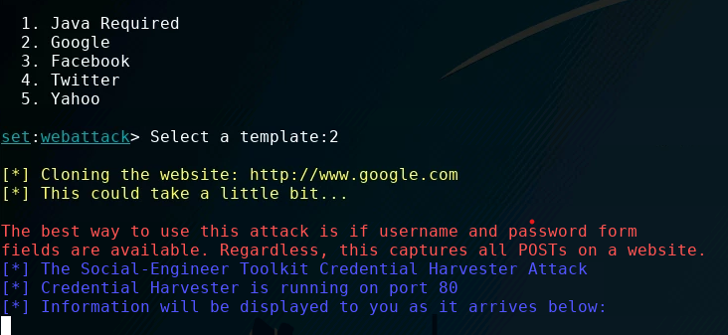
Launching the Attack
To set the site up as a Google login page, press 2 and ENTER
You should see that the attack is running and “Information will be displayed to you as it arrives below”
Verify it says “Information will be displayed to you as it arrives below:”

Slide 12
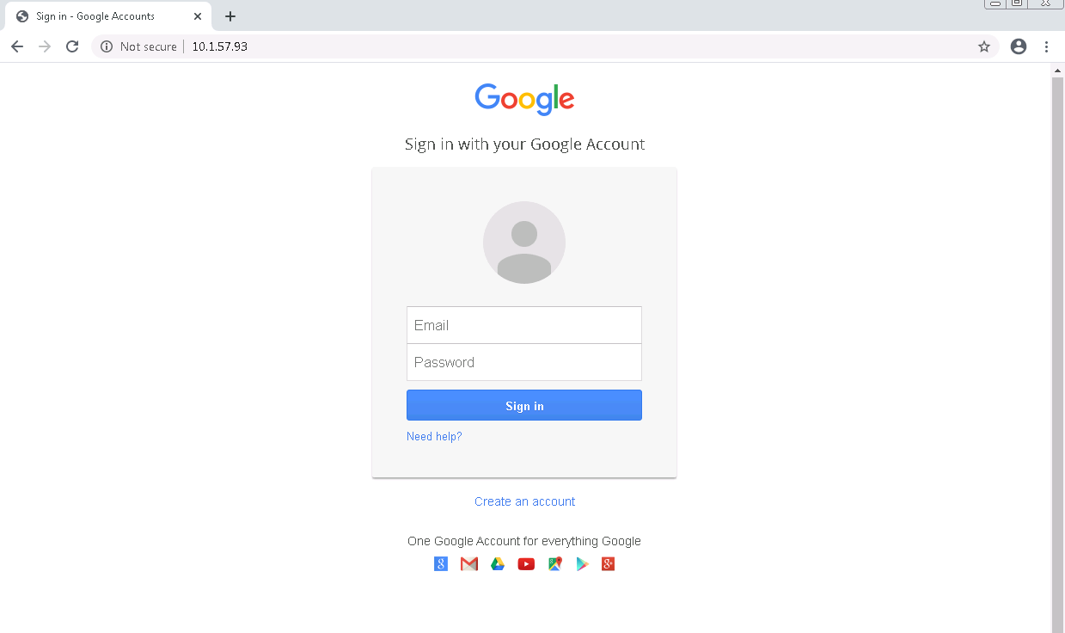
Playing the Victim
In the Windows environment, open the Chrome Browser
Go the website of the URL for Kali
Kali-IP-Address (as the URL)
Notice that this looks exactly like a login page for a standard Google account
This is the webpage that should load

Slide 13
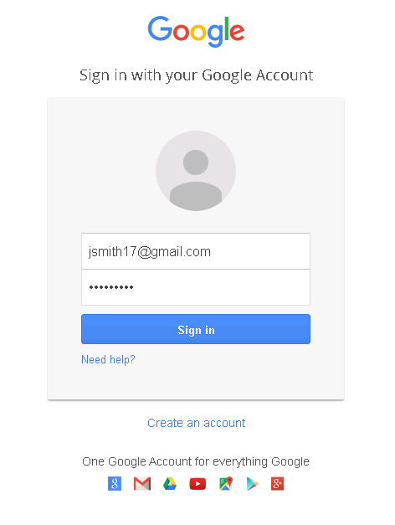
Playing the Victim
Now, type in fake credentials to this webpage as if you were going to log into a Google account
Notice, once you log in, it simply takes you to www.google.com, but you are not signed into Google.
Enter fake credentials

Slide 14
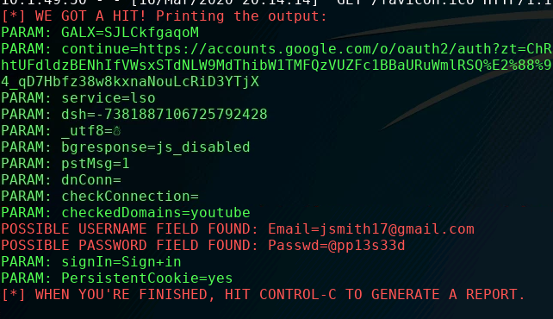
Seeing the Attack
Go back to Kali
It should show you that it has “GOT A HIT!” and will show the username and password in plaintext
Notice, you should see the fake credentials that were entered into the fake Google Authentication page

Slide 15
How to Defend Against a Credential Harvesting Attack?
Only use credentials at trusted websites!
What was the website URL you entered your credentials in?
Watch for "watering hole" type attacks at sites that look similar to your intended destination
Avoid re-using passwords across multiple websites
If one site steals your password once and they're all the same...
Two-Factor Authentication
Why would these help secure your password?
What are some other ways of defending against a credential harvesting attack?

